Slide 1

Model Development of British Airways Customer Reviews

Slide 2

Dataset Overview
Dataset Information:
Number of Rows: 50,000
Number of Columns: 14
Memory Usage: 5.3 MB
Column Types:
Numeric Columns: 9 (e.g., num_passengers, purchase_lead)
Categorical Columns: 5 (e.g., sales_channel, trip_type, route)

Slide 3
Columns in Dataset
Columns:
num_passengers: Number of passengers in the booking.
sales_channel: Booking platform (e.g., Internet).
trip_type: Type of trip (e.g., RoundTrip).
purchase_lead: Days between booking and travel.
flight_duration: Flight duration in hours.
booking_complete: Target variable (1 = booking made, 0 = booking not made).

Slide 4
Dataset Statistics
Column | Mean | Median | Std. Dev | Min | Max
num_passengers | 1.59 | 1.00 | 1.02 | 1.00 | 9.00
purchase_lead | 84.94 | 51.00 | 90.45 | 0.00 | 867.00
length_of_stay | 23.04 | 17.00 | 33.88 | 0.00 | 778.00
flight_hour | 9.07 | 9.00 | 5.41 | 0.00 | 23.00
flight_duration | 7.28 | 7.57 | 1.50 | 4.67 | 9.50

Slide 5
Categorical Data Insights
Percentile | num_passengers | purchase_lead | length_of_stay | flight_hour | flight_duration
25% | 1.00 | 21.00 | 5.00 | 5.00 | 5.62
50% | 1.00 | 51.00 | 17.00 | 9.00 | 7.57
75% | 2.00 | 115.00 | 28.00 | 13.00 | 8.83

Slide 6
Preparing the Dataset
Encode Categorical Variables:sales_channel, trip_type, flight_day, etc.
Feature Engineering:Create new features like is_weekend, lead_time_category, etc.
Scale Numeric Features:Normalize columns like purchase_lead, length_of_stay, flight_duration.
Target Variable : booking_complete
Cleaned and handled categorical data.
Performed train-test split (70-30 ratio).
Preprocessed features and ensured the dataset was model-ready.

Slide 7
Model Training
Algorithm Used: Random Forest Classifier
Reason:
Ability to measure feature importance.
Robust to overfitting with hyperparameter tuning.
Handles large datasets effectively.
Hyperparameters: Default settings with a random state for reproducibility.

Slide 8
Model Evaluation
Metrics Evaluated:
Precision, Recall, F1-Score, and Accuracy.
Macro Average vs. Weighted Average.
Classification Report Results:
Accuracy: 85%
Class 0 (No Booking): High precision (87%) and Recall (97%).
Class 1 (Booking): Lower recall (14%), indicating challenges in predicting positive bookings.

Slide 9
Cross-Validation
Approach: K-Fold Cross-Validation (5 folds)
Goal: Assess model stability and reduce overfitting risk.
Results: (Placeholder for cross-validation results)
Average accuracy: ~84.5%

Slide 10
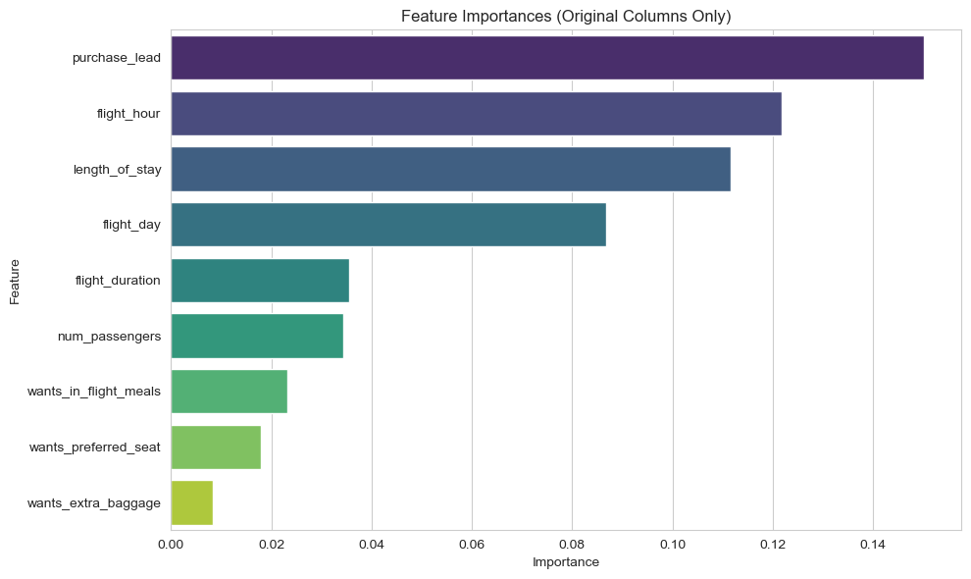
Feature Importance Visualization

Slide 11
Insights and Interpretations
Model Insights:purchase_lead and length_of_stay are the strongest predictors.
Customer preferences (e.g., extra baggage, preferred seat) contribute moderately.
Challenges:Imbalanced dataset leading to lower recall for Class 1.
Potential need for advanced balancing techniques.

Slide 12
Recommendations
Focus on customers with shorter purchase_lead times for targeted marketing.
Explore additional data sources to enrich feature set (e.g., customer demographics).

